Slide 1


Department of Transportation
Ministry of Road and Urban Development
LOGISTICS CENTERS

Slide 2

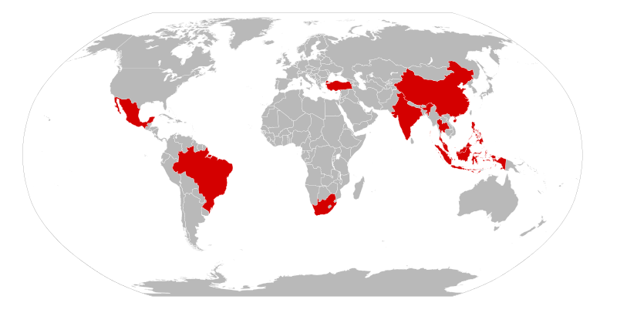

IRAN
PRICE WATERHOUSE COOPERS Transport and Logistics 2030
Emerging Markets
☞ Demand
☞ Inefficiency
Emerging Markets

Slide 3






IRAN Logistics at a Glance
Present
+400 MT
+200 MT
New Plan
Transit
Sea
Rail
Road
9
Million ton
145
Million ton
40
Million ton
283
Million ton

Slide 4


Opportunity for more efficiency
Transportation cost / Total Product Cost
12%
6%
Global average
IRAN

Slide 5


Opportunity for more efficiency
Total Logistics Cost / GDP
+20%
13%
8%
Emerging markets
Developed Countries
IRAN

Slide 6
Opportunity for more efficiency
Modal Split by Ton-Kilometer

Slide 7
Opportunity for more efficiency
Modal Split by Ton-Kilometer

Slide 8
Opportunity for more efficiency
Modal Split by Ton-Kilometer

Slide 9
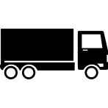
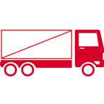
Opportunity for more efficiency
40%
Empty Truck Returns

Slide 10
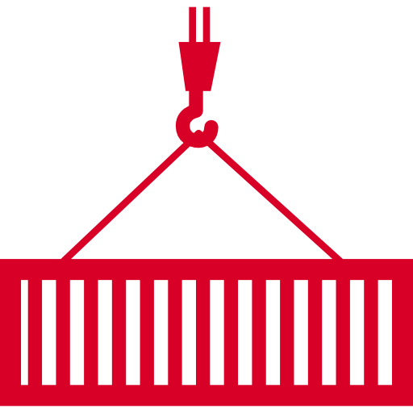
Opportunity for more efficiency
7%
Containerized Cargo

Slide 11
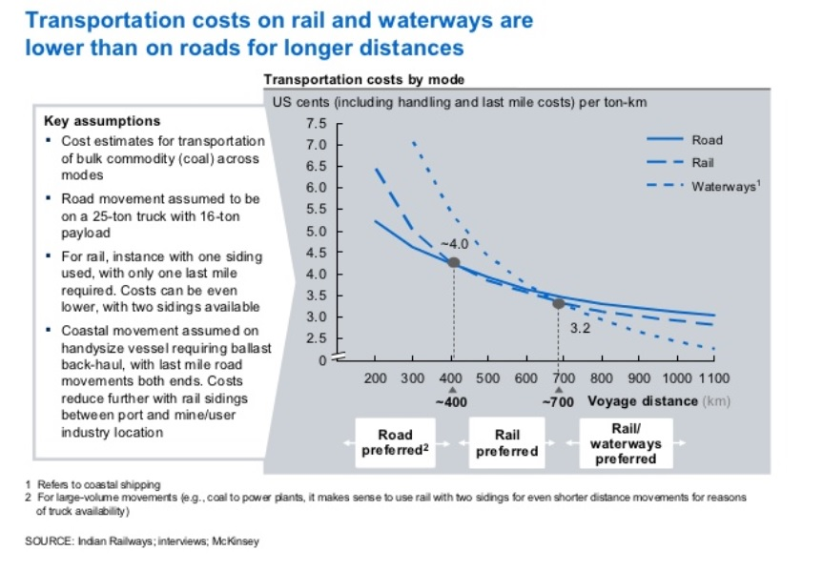
Opportunity for more efficiency
A cooperative rather than competitive approach in freight transport among transport modes

Slide 12
Freight Transport Major Strategy
Increasing Rail Share
via Intermodality

Slide 13





Freight Strategy Pillars
Efficient Logistics Industry
Intermodality
Increasing Rail Mode Share
Intermodal Logistics Centers
Logistics Service Providers
Logistics
Information Systems
Containerization
Improvement in Transport Market Environment

Slide 14

Actions
Logistics Centers
Network
Formation of National Logistics Centers Council
Logistics Centers Network Design
Regulations, Provisions and Standards

Slide 15
Organizational Structure
Supreme Council of Transportation Coordination
National Logistics Centers Council
Deputy Minister of Transportation
Ministry of Industry, Mines and Trade
Road Maintenance and Transportation Organization
Railway of Islamic Republic of Iran
Iran Airports and Air Navigation Company
Transportation and Logistics Federation of Iran
Islamic Republic of Iran Customs Administration
Iran Chamber of Commerce
Ports and Maritime Organization

Slide 16
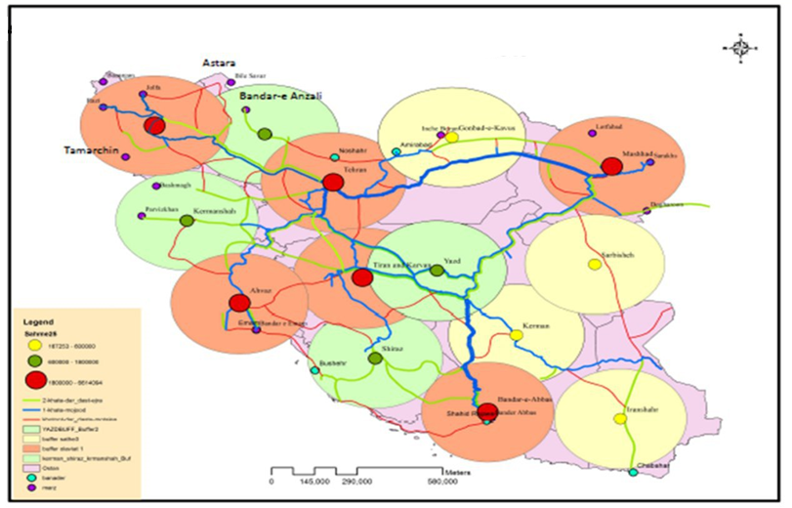
Logistics Centers Network Design
Main freight origins and destinations

Slide 17
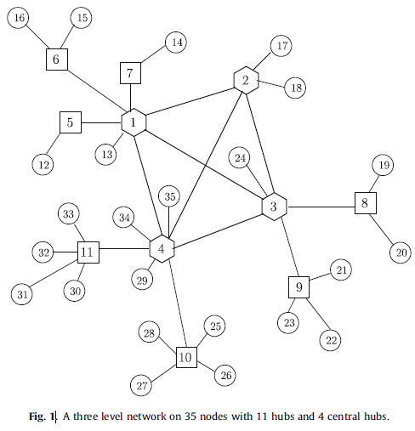
Logistics Centers Network Design
Operations Research Model based on:
Freight trip generation and consumption centers
National and international corridors
Minimization of establishment and operational costs

Slide 18
Site Selection
Logistics Centers
And Network
Operations Research Model Results:
Logistics centers locations
Logistics centers classification
Logistics Network Requirements for National Transport Masterplan

Slide 19
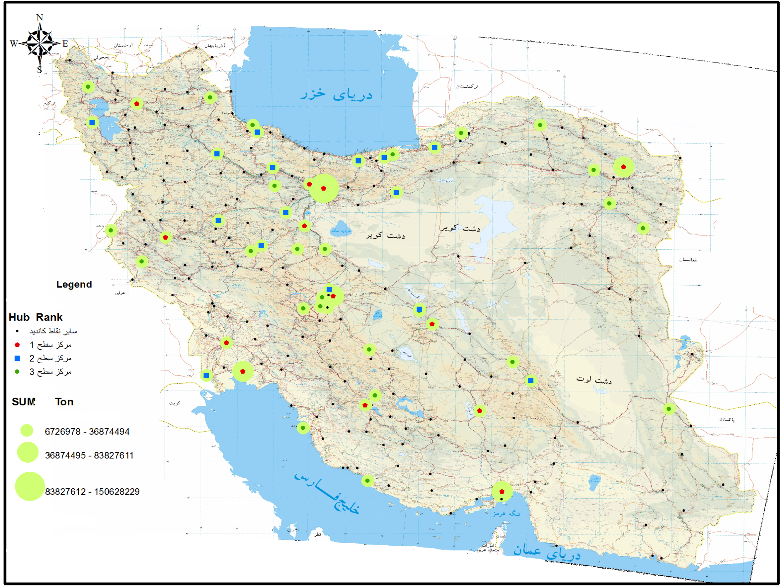
Outline
Logistics Centers
And Network

Slide 20




Regulations and Provisions
Logistics Centers
And Network
Logistics Centers Council and sub-committees to be formed by stakeholders
Classification and Definition of LCs:
Logistics Hubs
Logistics Parks
Freight Terminals
Public organizations in charge of establishment and operation of LCs
Provisions of Establishment and Operation of Logistics Centers
2017
…

Slide 21

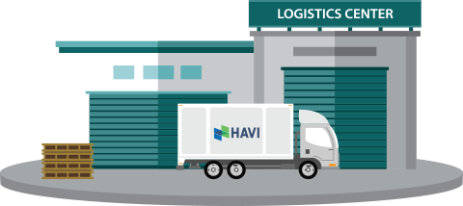

Logistics Centers Classification
Logistics Centers Classification
+
- Capacity
International significance
Service diversity
-
Freight Terminals
Logistics Parks
Logistics Hubs

Slide 22
Regulations and Provisions
Guidelines and Standards
Logistics centers Strategies
PPP guideline
Establishment standards
Operation standards

Slide 23

Mehdi Safari Moghadam
me.safari@mrud.ir
Transportation and Logistics Comprehensive Planning General Director
THANK YOU

